Slide 1






Azure iOT Hub
PowerShell Conference Asia
Senthamil Selvan

Slide 2

Agenda
About me
Azure iOT hub
Why Azure iOT hub
Gateway
How it works?
Scenarios and Devices
Device Management
PowerShell scripts
PowerShell Conference
Singapore 2017

Slide 3












Senthamil Selvan
Microsoft MVP (Windows Development)
Blog: http://altfo.wordpress.com
Twitter : @altfo
Tweets : #MSIsGreat
Azure Bootcamp 2016
Animal Taxonomy
IUPAC
Math Formulas
Ultimate Player
SG Parking
SG Things To Do
Mani Samayal
PowerShell Conference Asia 2015
SEASPC
System Center Universe 2016

Slide 4
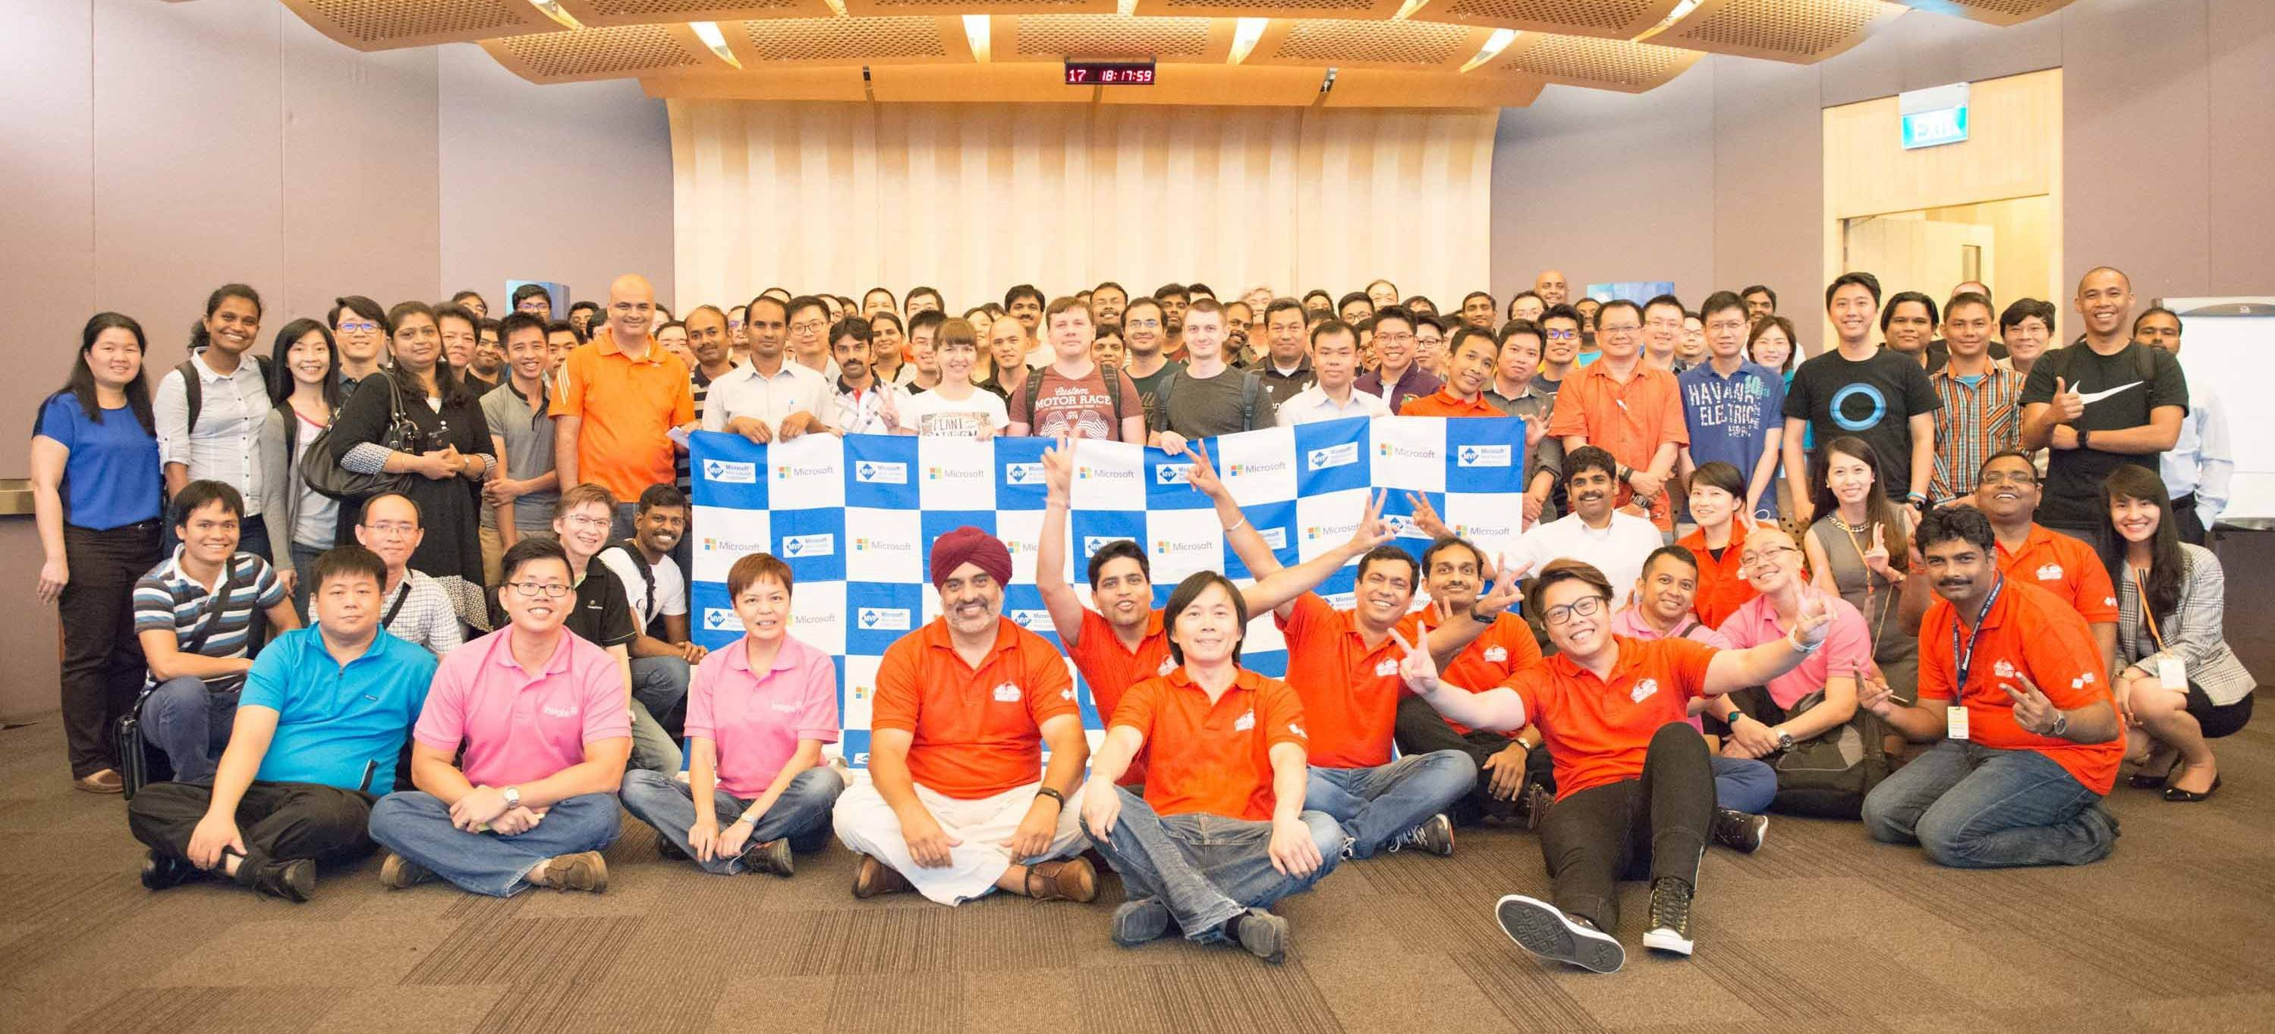
Singapore User Group & Meetups
https://www.facebook.com/groups/MSTechCommunitiesSG
https://www.meetup.com/mssgug/
Facebook Group
Meetup Events

Slide 5
Azure iOT hub
Provides multiple device-to-cloud and cloud-to-device communication options. These options include one-way messaging, file transfer, and request-reply methods.
Provides built-in declarative message routing to other Azure services.
Provides a queryable store for device metadata and synchronized state information.
Enables secure communications and access control using per-device security keys or X.509 certificates.
Provides extensive monitoring for device connectivity and device identity management events.
Includes device libraries for the most popular languages and platforms.
PowerShell Conference
Singapore 2017

Slide 6
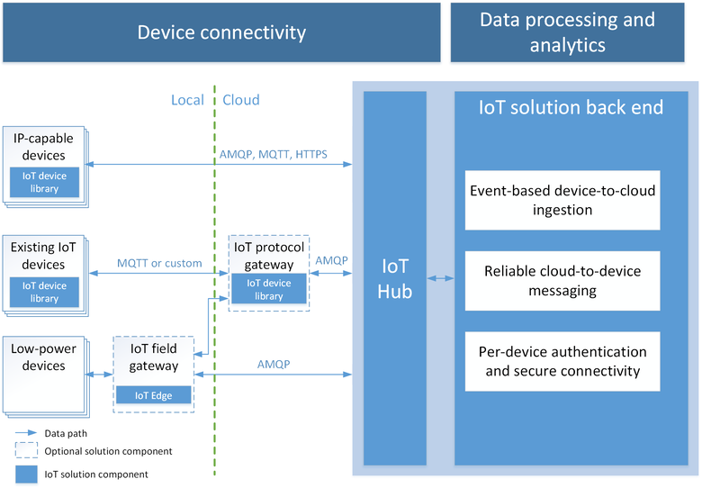
PowerShell Conference
Singapore 2017

Slide 7
Features
Device twins
Per-device authentication and secure connectivity
Route device-to-cloud messages to Azure services based on declarative rules
Monitoring of device connectivity operations
IoT protocols and extensibility.
PowerShell Conference
Singapore 2017
Notes:
Device twins. Using Device twins, you can store, synchronize, and query device metadata and state information. Device twins are JSON documents that store device state information like metadata, configurations, and conditions. IoT Hub maintains a device twin for each device that you connect to IoT Hub.
Per-device authentication and secure connectivity. You can provision each device with its own security key to enable it to connect to IoT Hub. The IoT Hub identity registry stores device identities and keys in a solution. A solution back end can add individual devices to allow or deny lists to enable complete control over device access.
Route device-to-cloud messages to Azure services based on declarative rules. IoT Hub enables you to define message routes based on routing rules to control where your hub sends device-to-cloud messages. Routing rules do not require you to write any code, and can take the place of custom post-ingestion message dispatchers.
Monitoring of device connectivity operations. You can receive detailed operation logs about device identity management operations and device connectivity events. This monitoring capability enables your IoT solution to identify connectivity issues. Use these logs to identify devices that provide wrong credentials, send messages too frequently, or reject all cloud-to-device messages.
An extensive set of device libraries. Azure IoT device SDKs are available and supported for various languages and platforms--C for many Linux distributions, Windows, and real-time operating systems. Azure IoT device SDKs also support managed languages, such as C#, Java, and JavaScript.
IoT protocols and extensibility. If your solution cannot use the device libraries, IoT Hub exposes a public protocol that enables devices to natively use the MQTT v3.1.1, HTTPS 1.1, or AMQP 1.0 protocols. You can also extend IoT Hub to support custom protocols by:
Creating a field gateway with Azure IoT Edge that converts your custom protocol to one of the three protocols understood by IoT Hub.
Customizing the Azure IoT protocol gateway, an open source component that runs in the cloud.
Scale. Azure IoT Hub scales to millions of simultaneously connected devices and millions of events per second.

Slide 8
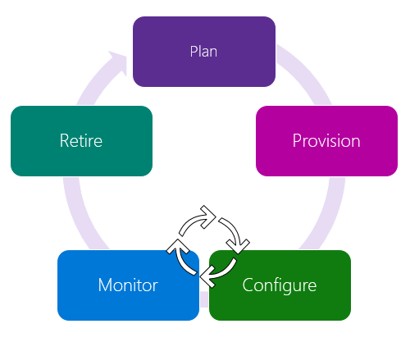
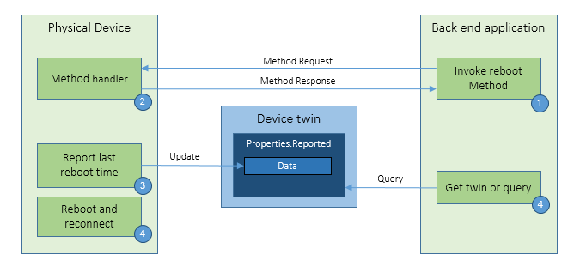
Device Management
PowerShell Conference
Singapore 2017

Slide 9
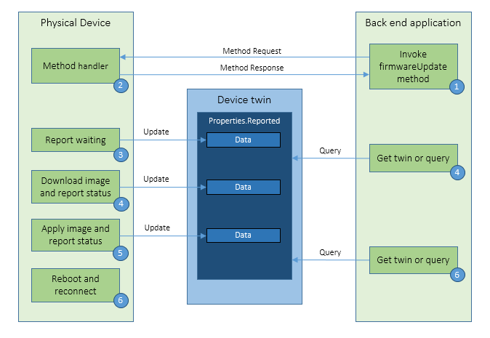
Device Management
PowerShell Conference
Singapore 2017

Slide 10
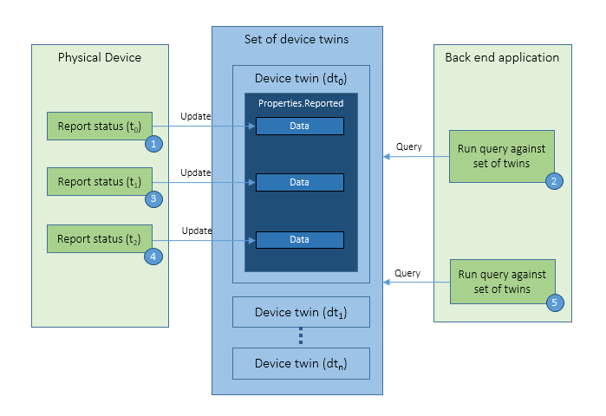
Device Management
PowerShell Conference
Singapore 2017

Slide 11
Add-AzureRmIotHubEventHubConsumerGroup | Creates an eventhub consumer group.
Add-AzureRmIotHubKey | Creates an IotHub Key.
Get-AzureRmIotHub | Gets information about the IotHubs in a subscription.
Get-AzureRmIotHubConnectionString | Gets the IotHub connectionstrings.
Get-AzureRmIotHubEventHubConsumerGroup | Gets all the eventhub consumergroups.
Get-AzureRmIotHubJob | Gets the information about an IotHub job.
Get-AzureRmIotHubKey | Gets an IotHub Key.
Get-AzureRmIotHubQuotaMetric | Gets the Quota Metrics for an IotHub.
Get-AzureRmIotHubRegistryStatistic | Gets the RegistryStatistics for an IotHub.
Get-AzureRmIotHubValidSku | Gets all valid skus that this IotHub can transition to.
New-AzureRmIotHub | Creates a new IotHub.
New-AzureRmIotHubExportDevices | Creates a new export devices job.
New-AzureRmIotHubImportDevices | Creates a new import devices job.
Remove-AzureRmIotHub | Deletes an IotHub.
Remove-AzureRmIotHubEventHubConsumerGroup | Deletes an eventhub consumergroup.
Remove-AzureRmIotHubKey | Removes an IotHub Key.
Set-AzureRmIotHub | Updates the properties of an IotHub.
Notes:
Login-AzureRmAccount
Get-AzureRMSubscription
Select-AzureRMSubscription ` -SubscriptionName "{your subscription name}"
((Get-AzureRmResourceProvider ` -ProviderNamespace Microsoft.Devices).ResourceTypes ` | Where-Object ResourceTypeName -eq IoTHubs).Locations
New-AzureRmResourceGroup -Name MyIoTRG1 -Location "East US"
New-AzureRmIotHub ` -ResourceGroupName MyIoTRG1 ` -Name MyTestIoTHub ` -SkuName S1 -Units 1 ` -Location "East US"
Get-AzureRmIotHub
Remove-AzureRmIotHub ` -ResourceGroupName MyIoTRG1 ` -Name MyTestIoTHub

Slide 12
Don’t Forget!
Fill in your survey in Mobile app – it’s how we do better!
Don’t lose you badge! You need it for the Social Events
Grab the Speakers for a chat – they all have time for you!
Let everyone know what they are missing on Social Media
#PowerShell
#PSConfAsia
Photos of Marina Bay Credit: Sebastian Szumigalski
PowerShell Conference
Singapore 2017

